Slide 1

School Management Systems

Slide 2
Presented by –
Md. Monzurul Alam Sajal (19202103007)
Sourov Karmokar (19202103020)
Sihab Mahmud (19202103032)
Sourav Hazra (19202103036)
Supervised by –
Most. Jannatun Ferdous
Lecture, Department of CSE
Bangladesh University of Business
and Technology (BUBT)

Slide 3
Education system forms the backbone of every nation. And hence it is important to provide a strong educational foundation to the young generation to ensure the development of open-minded global citizens securing the future for everyone. Advanced technology available today can play a crucial role in streamlining education-related processes to promote solidarity among students, teachers, parents and the school staff. School Management System consists of tasks such as registering students, attendance record keeping controlling absentees, producing report cards. producing official transcript, preparing timetable and producing different reports for teachers and parents The appearance of your student records says a lot about the quality of your school Other educators and registrars make judgments based on student records that can permanently affect a student's life. SMS capabilities include the basics such as transcripts, report cards, attendance, and discipline as well as many other specialized capabilities, including parental access to real time student grades on the Internet. This means that not only administrators but also. parents, teachers, and students have access to real-time data.
Introduction

Slide 4
Objective
The main objective of the School Management System is to manage the details of Schools, Students, Classes, Teachers, Registrations. It manages all the information about Schools, Cources Registrations, Schools. The project is totally built at administrative end and thus only the administrator is guaranteed the access

Slide 5
Features
1. Management Dashboard.
2. Data analysis and reports.
3. Inquiries and admission tracking.
4. Student profile tracking for parent's meet / key inputs.
5. Class wise performance tracking.
6. Teachers activity analysis.
7. Lesson progress tracking.
8. Fees and financial data analysis.

Slide 6
Why chosen
Maintaining school operations is a crucial task for any educational institute.
Manual work at school is a daunting task, and sometimes it contains errors.
Technology has assisted us to overcome these issues. In this digital era, the availability of online software helps to automate most school operations efficiently.
A school management system benefits the school in many way.

Slide 7
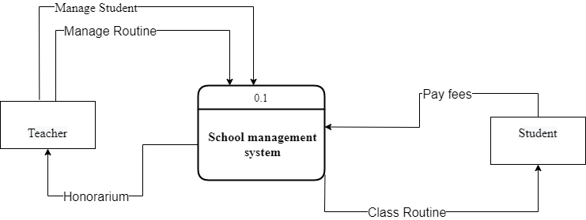
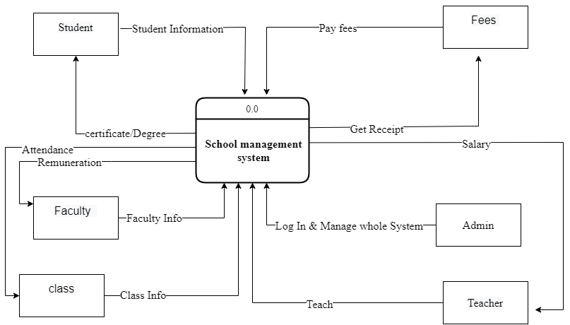
Data Flow Diagram (Context level )
Existing System
Proposed System

Slide 8
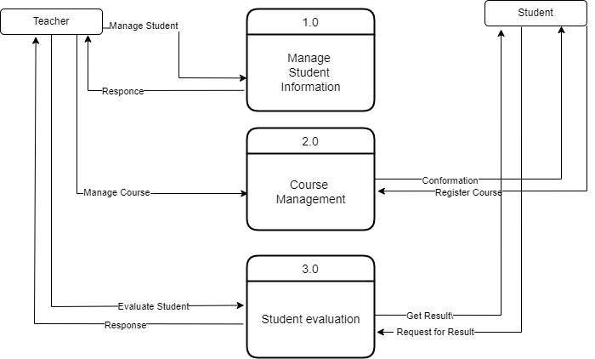
0 Level DFD
Existing System

Slide 9
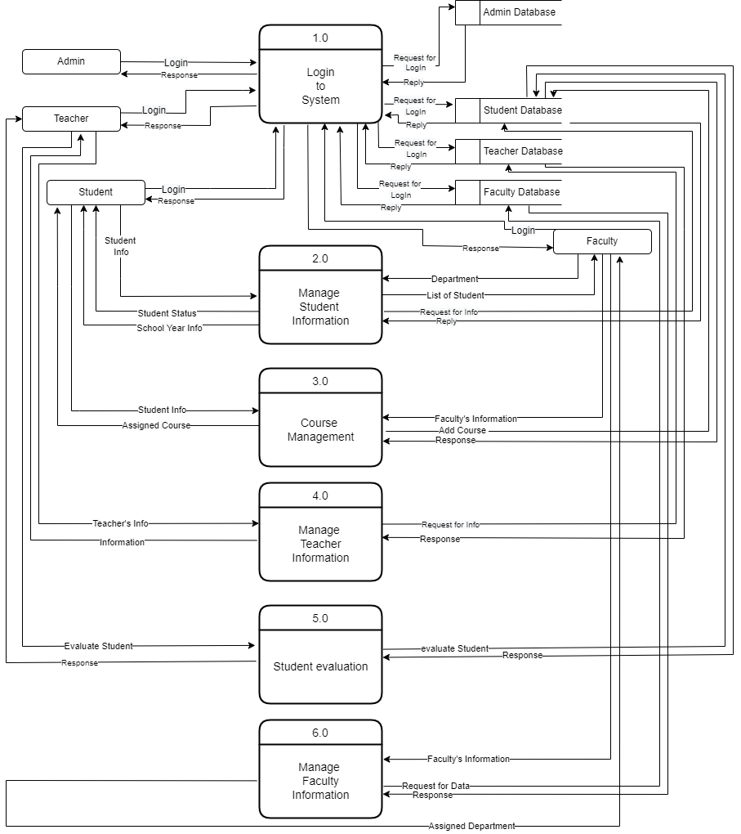
Proposed System

Slide 10
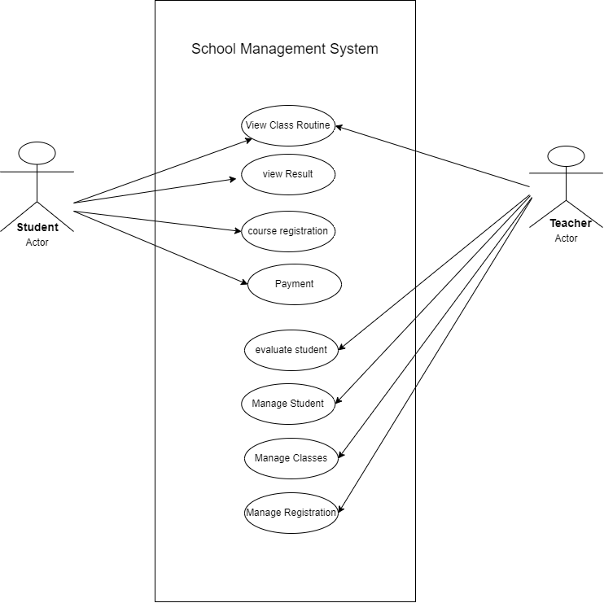
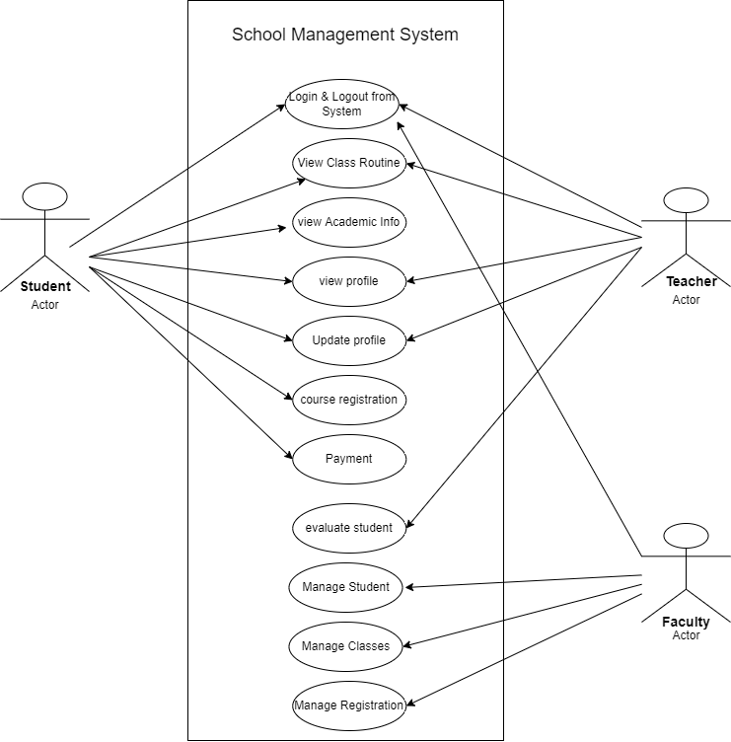
Use-Case Diagram
Existing System
Proposed System

Slide 11
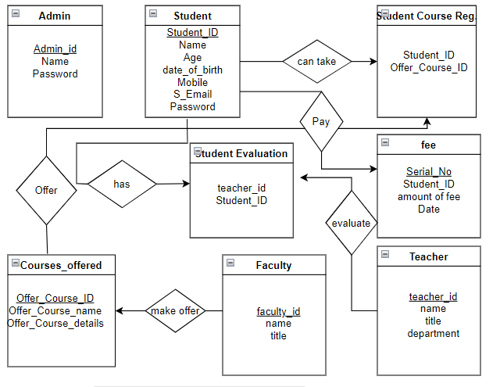
ER Diagram
Proposed System

Slide 12
Feasibility Analysis of the System
Feasibility study is a step towards identification of the candidate system as a feasible product. First the studies often pre-suppose that when the feasibility document is being prepared, the analyst is in a position to evaluate solutions. Second, most studies tend to overlook the confusion inherent in system development – the constraints and the assumed attitudes.

Slide 13
Economical Feasibility
Cost:(System Devlopment(website) + Computer + Rauter + Internet + Others)
Capital=50,000+1,00,000+5000+10,000+20,000= 1,85,000/-
Per Month Cost:
System Maintenance : 5,000/-
Utility Bill : 2,000/-
IT Executive : 12,000/-
Account Officer : 10,000/-
Launch Bill+ Others: 11,000/-
So,Total Cost Per Month = 40,000/-
Where Per Month come from Student= 60,000/-
Per Month Revenue= 80,000 - 60,000 = 20,000/-
Payback Period:
Simple Cost: 1,85,000/-
Savings: 20,000/- (per month)
Cost recovered in: (1,85,000 / 20,000) = 9 Months
So,Total cost will be recovered in 9 months(approximately).

Slide 14
Design of this System
Student Login Dashboard Class routine Course Reg Result Payment Notice Setting | Teacher Login Teacher Dashboard Routine Student List Student evaluation Setting Notice | Faculty Dashboard Routine Management Student Management Teacher Management Setting Foregate password

Slide 15
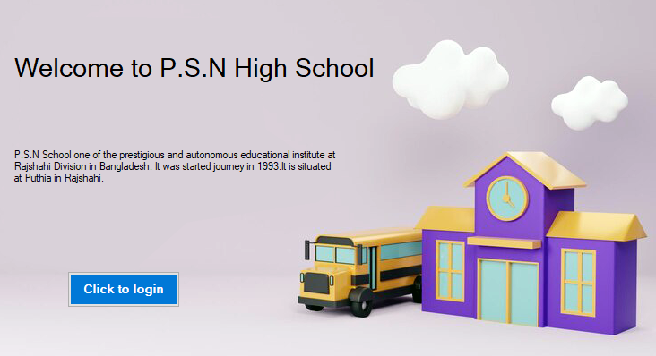
Home Page

Slide 16
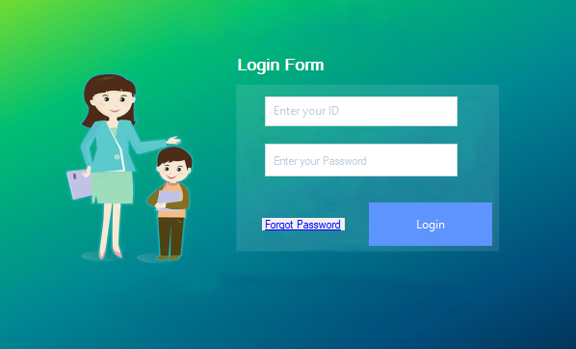
Login Page

Slide 17
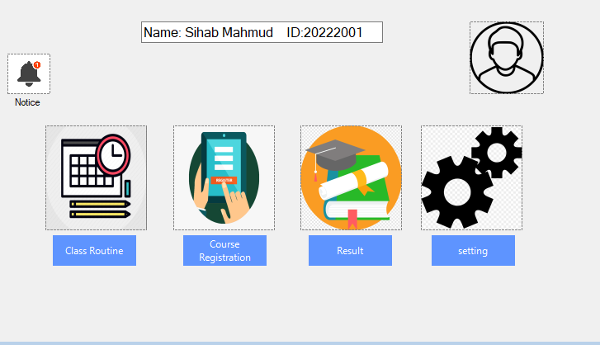
Student Dashboard

Slide 18
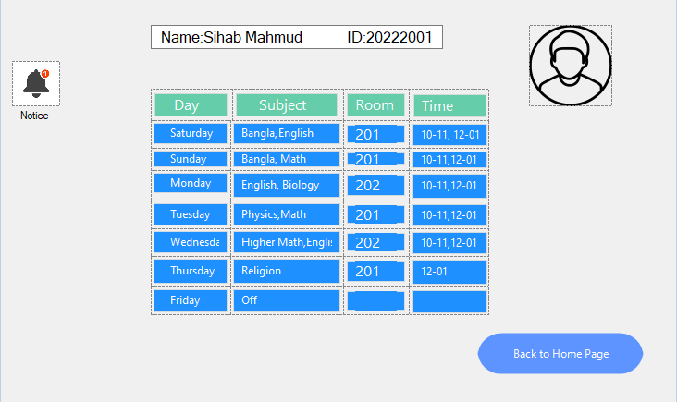
Class Routine

Slide 19
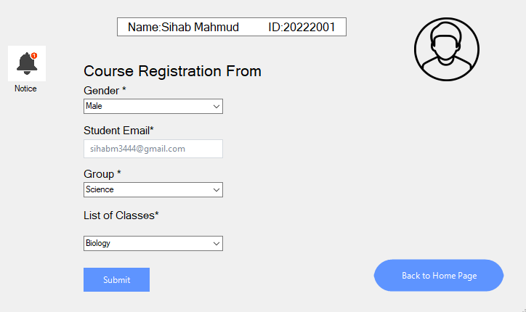
Course Registration

Slide 20
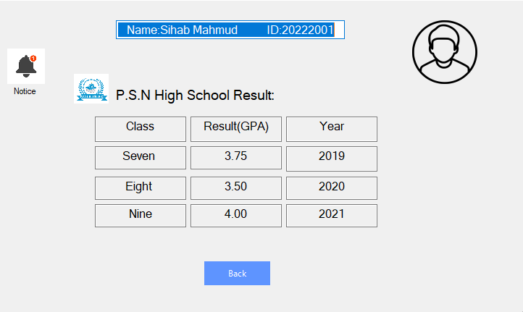
Result

Slide 21
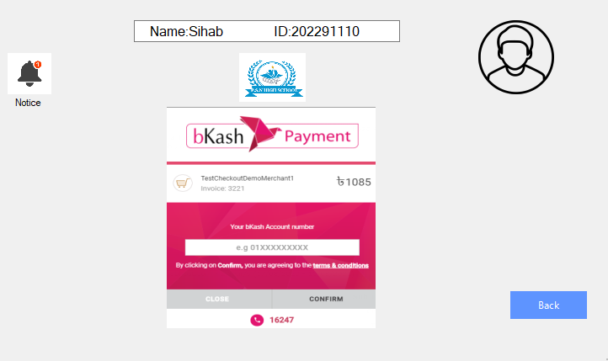
Payment

Slide 22
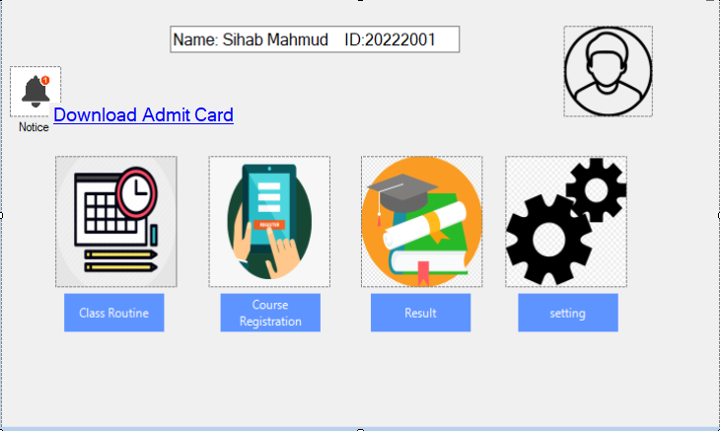
Notice

Slide 23
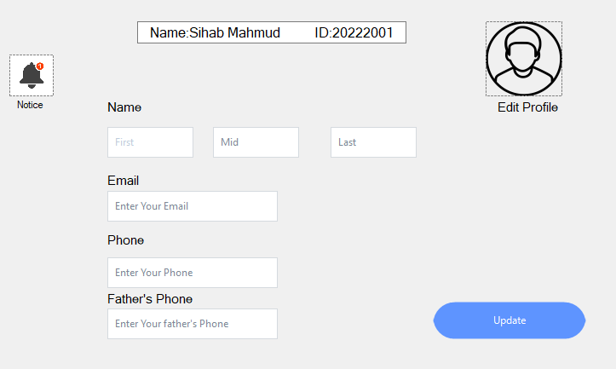
Setting

Slide 24
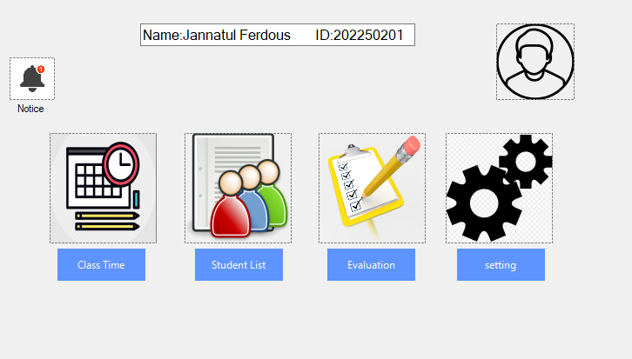
Teacher Dashboard

Slide 25
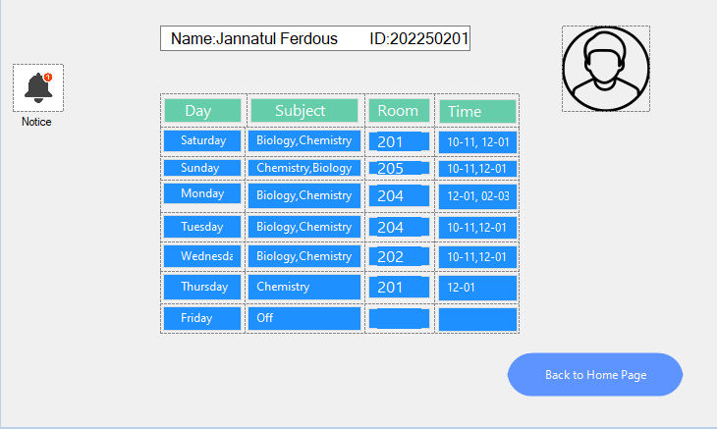
Routine

Slide 26
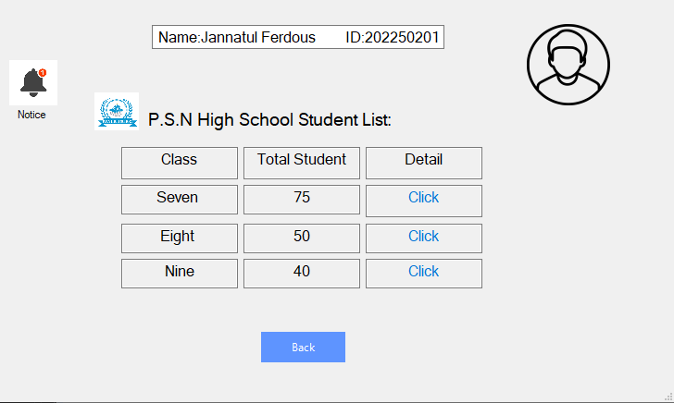
Student List

Slide 27
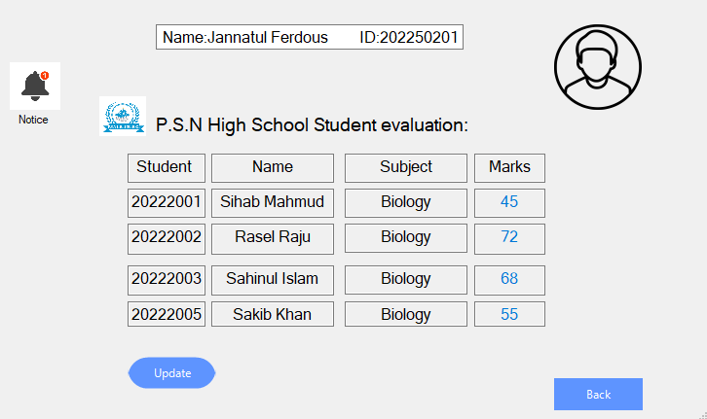
Student Evaluation

Slide 28
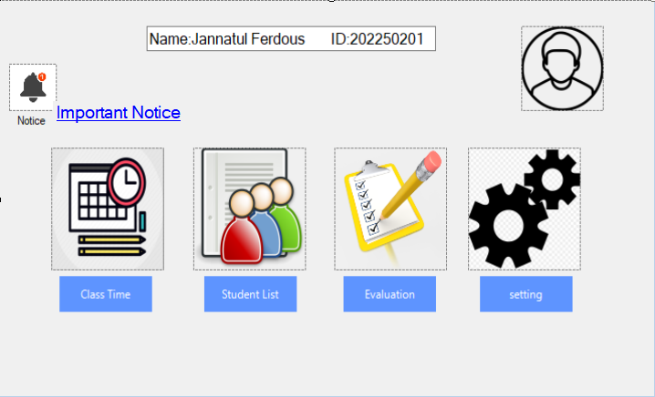
Notice

Slide 29
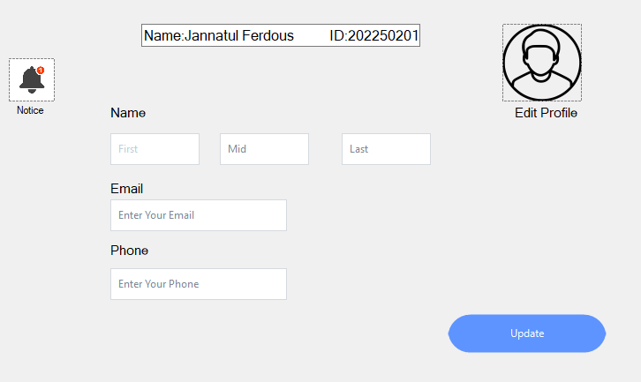
Setting

Slide 30
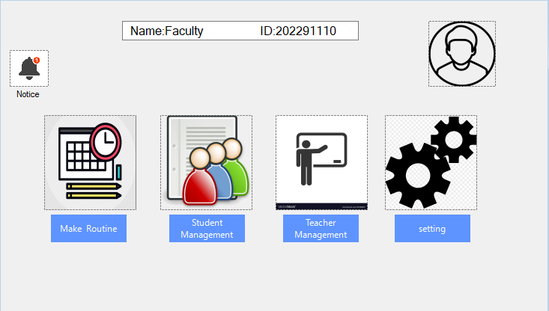
Faculty Dashboard

Slide 31
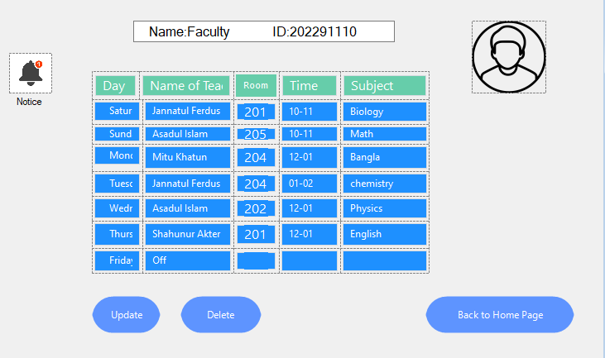
Routine Management

Slide 32
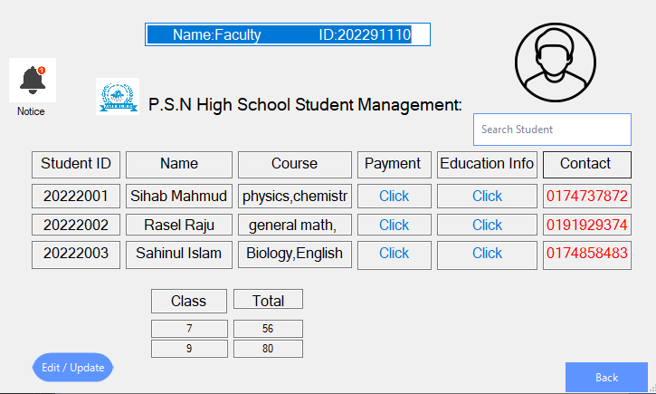
Student Management

Slide 33
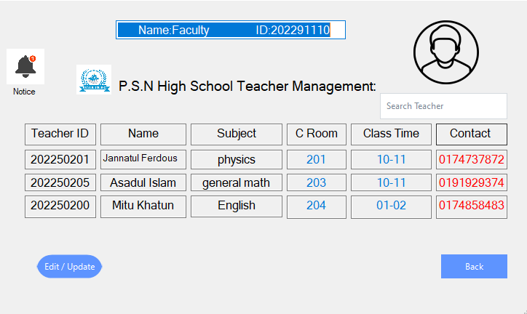
Teacher Management

Slide 34

Setting

Slide 35
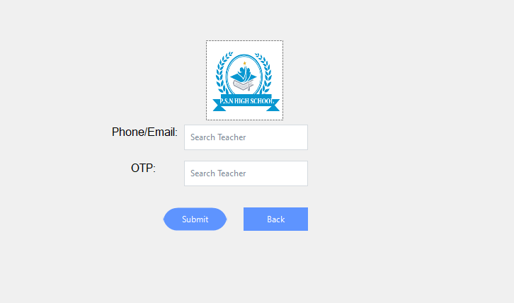
Forget Password

Slide 36
Future Work
This system provides pre-defined features for every user that in-cludes students, teachers, parents, as well as admin staff. The features for admin will include Instant announcements, Admission management, fee management, schedule management, staff management, and more. Features like Blood Group,Result’s graph and more will help the students and parents to be informed about their school work. School management software generally comes with essential features for the improved collaborate and communicate between the school and end users. School management system apps have made notable difference schools. Let’s look at the how these apps will change the face of education in the future.

Slide 37
Conclusion
School Management Systems are being identified as an appropriate method for managing information in schools. SMS was build based on real life situations in P.S.N High School, taking into consideration all possible situations and functionalities of the daily work in these schools. This system considered as a good first step in implementing per- forming online based information management in schools.

Slide 38
Thanks You

Slide 39
Any Questions?

